Slide 1

Microsoft Azure Azure Storage Story
Amy Nicholson – Technical Evangelist
@AmyKateNicho

Slide 2


Slide 3

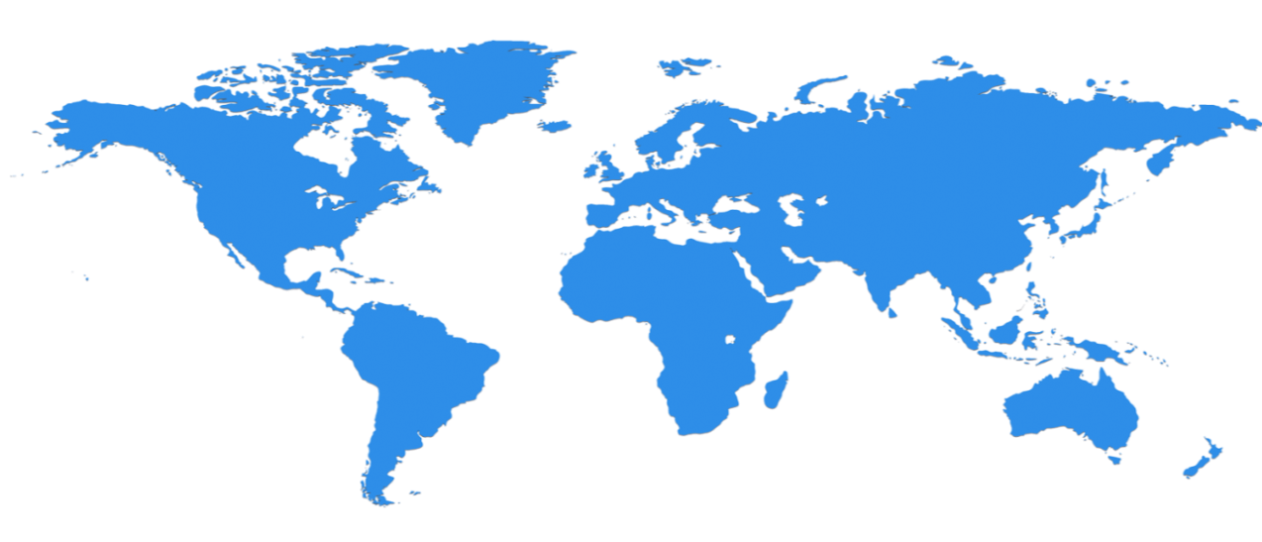

Huge infrastructure scale is the enabler
24 Regions Worldwide…huge capacity around the world…growing every year
UK
North Central US
Illinois
Germany
North Europe
Ireland
West Europe
Netherlands
Central US
Iowa
Canada Central
Toronto
Canada East
Quebec City
US Gov
Iowa
China North *
Beijing
China South *
Shanghai
Japan East
Saitama
West US
California
East US
Virginia
India Central
Pune
Japan West
Osaka
South Central US
Texas
East US 2
Virginia
US Gov
Virginia
India South
Chennai
India West
Mumbai
East Asia
Hong Kong
SE Asia
Singapore
Australia East
New South Wales
Brazil South
Sao Paulo
Australia South East
Victoria
100+ datacenters
Top 3 networks in the world
2x AWS, 6x Google DC Regions
G Series – Largest VM in World, 32 cores, 448GB Ram, SSD…
Operational
Announced/Not Operational
* Operated by 21Vianet

Slide 4
Azure StorSimple
Azure in Open
Azure Government
Azure SQL Database
Rights Management (RMS)
Azure API Management
Azure Site Recovery
Azure Automation
Instance Level Public Ips
Azure Redis Cache
Azure Batch
Azure Marketplace
Azure Data Factory
Stream Analytics
Event Hubs
Operational Insights
Premium Storage
Virtual Machine Converter 3.0
Cloud Platform System (CPS)
Antimalware for Cloud Services and VMs
Identity Manager vNext
Analytics Platform System (APS)
Visual Studio Community 2013
Visual studio 2015 Preview
.NET 2015
Azure RemoteApp
Azure AD Basic
SSD-based instances for Microsoft Azure VMs and Cloud Services
Azure SQL Database Auditing
Live Channels for Azure Media Services
AAD Application Proxy
New experiences in Power BI
Azure DocumentDB
Azure Search
HDInsight for Storm Public Preview & GA
Azure Zone Redundant Storage
HDInsight for Hbase
WSSC vNext tech preview
Content Protection pub preview
Intune - Nov update and Dec update
Azure AAD premium features
Multi-Factor Auth enhancements
Cloudera and Hortonworks on clustered Azure VMs
Azure Instance level IP
Azure Role Based Access Controls
VPN support pub preview
TiP Testing pub preview
Azure AD Workday A148 Integration
Azure Standard SSG
ExpressRoute S2S, P2S GA
Azure Multiple NICs
Azure Networking Appliances
Azure Traffic Manager Nested policies
Azure VM Image Gallery expansion
Azure Vnet
Azure Web Jobs
VSO datacenter expansion
VSO REST Hooks pub preview
Australia datacenter
Forced Tunneling
WSSC Azure Packs
Azure G-Serves Instances
Azure Key Vault
Drivers for SQL Server
MDM for Office 365 public preview and GA
Azure Media Services Content Protection
Azure Mobile Engagement
Node.js Tools for Visual Studio
Visual Studio 2013 updates
Auto-HA for SQL Server VM
Auto-Patching and Backup for SQL Server VMs
Azure SQL Database Increased Compatibility
Azure AD Connect Health pub preview
Azure AD MFA Per App / Conditional access pub preview
Azure RMS controlled user deployment
Azure RMS departmental templates pub preview
Azure Site Recovery SAN Replication
ASP.NET 5 Preview
Azure SDK 2.5.1
Team Foundation Server 2015 preview
Azure Machine Learning GA
Azure HDInsight for Linux Pub Preview
Azure HDInsight Support for Hadoop 2.6 pub preview
Azure SQL Database security feature - Data Masking pub preview
Azure SQL Database security features - Encryption
Azure SQL Database security features - Row Level security
Azure AD: API for SIEM
Microsoft Intune monthly updates
Remote Desktop Client for Windows Phone 8.1
Azure App Service
Azure CDN Integration
Azure Media Encoder Premium
Azure AD Premium & Basic in CSP
Azure IoT Suite
Windows Server Containers
Hyper-V Containers
Windows Server Nano Server
Azure Media Player GA
Azure Service Fabric
Azure IoT Suite
Azure Site Recovery: Protect VMWare and Physical Servers in Public Preview
Azure Backup Generally Available
Azure API Management Premium simplifies high availability and massive scale for APIs
ExpressRoute for Office 365
Azure Active Directory Dynamic Membership For Groups
Automatic Password Change for Social Media Shared Accounts
Compute-Intensive A10 and A11 Virtual Machine Instances
Remote Desktop app for Windows Phone support for Gateway and Remote Resources
Informatica Cloud Agent availability in Linux and Windows Virtual Machines
Azure DocumentDB Hadoop Connector
Azure HDInsight support for more VM sizes
Enterprise-Grade Array-Based Replication and Disaster Recovery with ASR and System Center GA
500+
New releases in
the last 12 months

Slide 5
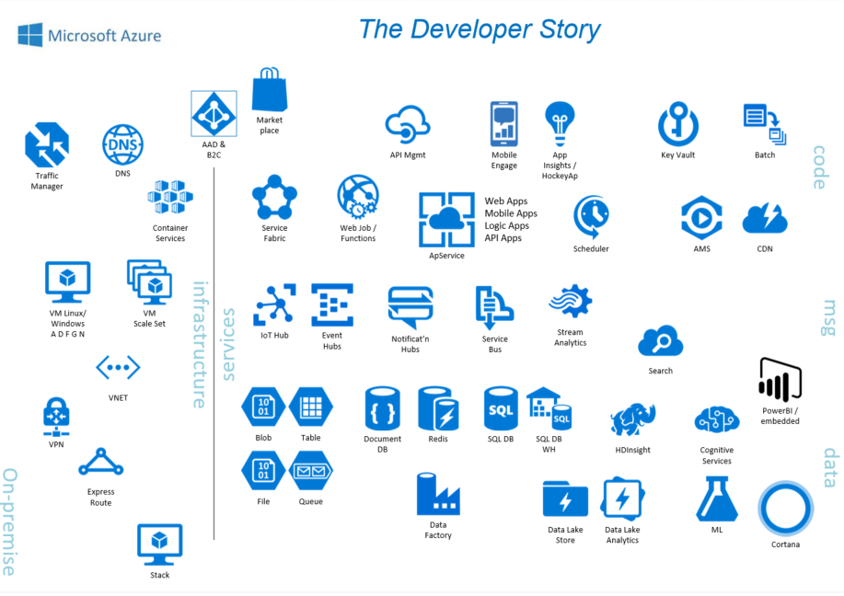

Slide 6
Azure Storage Services
IaaS
PaaS
Virtual machines
Existing frameworks
Web and mobile
Microservices
Serverless Compute
Storage
Networking
Disks
Persistent disks for Azure IaaS VMs
Premium Storage Disks option: SSD based, high IOPS, low latency
Files
Fully Managed File Shares in the Cloud
SMB and REST access
“Lift and shift” legacy apps
Objects
Highly scalable, REST based cloud object store
Block Blobs: Sequential file I/O
Cool Tier Available
Page Blobs: Random-write pattern data
Append Blobs
Tables
Massive auto-scaling NoSQL store
Dynamic scaling based on load
Scale to PBs of table data
Fast key/value lookups
Queues
Reliable queues at scale for cloud services
Decouple and scale components
Message visibility timeout and update message to protect against unreliable dequeuers
Built on a unified Distributed Storage System
Durability, Encryption at Rest, Strongly Consistent Replication, Fault Tolerance, Auto Load-Balancing
Notes:
Cloud services and cloud usage are broadly defined as existing across infrastructure services or IaaS and higher layer platform services or PaaS. The Azure Storage services span both categories.
On the IaaS side we provide single instance storage for VMs in the form of our Disks service and SMB shared storage which we call Azure Files.
On the PaaS side we provide an unstructured object store called the Blob Storage service which offers Exabyte scale and the ability to store trillions of objects across different tiers within the cloud. Our current cloud object storage tiers are hot storage for higher performance and frequently accessed data and cool storage for active archives. In addition to unstructured data, we also have the NoSQL Tables service for semi-structured and structured data and the Queues service for reliable intra and inter-service communication.

Slide 7
Azure Storage Durability
Typically >300mi
Typically >300mi
Async
Async
Primary
Secondary
Primary
Secondary
LRS
3 replicas, 1 region
Protect against disk, node, rack failures
Write is ack’d when all replicas are committed
Superior to dual-parity RAID
GRS
6 replicas, 2 regions (3/region)
Protects against major regional disasters
Asynchronous to secondary
RA-GRS
GRS + Read access to secondary
Separate secondary endpoint
RPO delay to secondary can be queried
Strong consistency, checksums/CRC and background scrubbing to preserve data integrity

Slide 8
Azure Storage Concepts
Container
Blobs
Table
Entities
Account
Queue
Messages
Share
Files

Slide 9
Azure Storage Services
IaaS
PaaS
Virtual machines
Existing frameworks
Web and mobile
Microservices
Serverless Compute
Storage
Networking
Disks
Persistent disks for Azure IaaS VMs
Premium Storage Disks option: SSD based, high IOPS, low latency
Files
Fully Managed File Shares in the Cloud
SMB and REST access
“Lift and shift” legacy apps
Objects
Highly scalable, REST based cloud object store
Block Blobs: Sequential file I/O
Cool Tier Available
Page Blobs: Random-write pattern data
Append Blobs
Tables
Massive auto-scaling NoSQL store
Dynamic scaling based on load
Scale to PBs of table data
Fast key/value lookups
Queues
Reliable queues at scale for cloud services
Decouple and scale components
Message visibility timeout and update message to protect against unreliable dequeuers
Built on a unified Distributed Storage System
Durability, Encryption at Rest, Strongly Consistent Replication, Fault Tolerance, Auto Load-Balancing
Notes:
Cloud services and cloud usage are broadly defined as existing across infrastructure services or IaaS and higher layer platform services or PaaS. The Azure Storage services span both categories.
On the IaaS side we provide single instance storage for VMs in the form of our Disks service and SMB shared storage which we call Azure Files.
On the PaaS side we provide an unstructured object store called the Blob Storage service which offers Exabyte scale and the ability to store trillions of objects across different tiers within the cloud. Our current cloud object storage tiers are hot storage for higher performance and frequently accessed data and cool storage for active archives. In addition to unstructured data, we also have the NoSQL Tables service for semi-structured and structured data and the Queues service for reliable intra and inter-service communication.

Slide 10
Azure Blob Storage
Account
Container
Blob
IMG001.PNG
amy
pictures
IMG002.PNG
data
tweets.txt
https://<accountname>.blob.core.windows.net/<containername>/<blobname>
https://amy.blob.core.windows.net/data/tweets.txt

Slide 11
Types of Blobs
Image.jpg
Block Blobs
Most object storage scenarios
Documents, images, video, etc.
Append Blobs
Multi-writer append only scenarios
Logging, Big Data Analytics output
Page Blobs
Page aligned random reads and writes
IaaS Disks, Event Hub, Block level backup
Block 1
Block 2
Block 3
Block 4
Block 1
Block 2
Block 3
Block 4
512
1024
1536
2048
Sparse File
512 byte aligned
2560
Notes:
Block Blobs
For most object storage needs
Optimized for sequential access
Each blob is made up of blocks
Append Blobs
Similar to Block Blobs
Can only append blocks to the end of the blob
Optimized for multi-writer append scenarios (logging, etc.)
Page Blobs
Optimized for random reads and writes
Collection of 512 byte pages
Support for sparse files

Slide 12
Azure Blob Storage .NET Application and programmatic storage access https://azure.microsoft.com/en-gb/documentation/articles/storage-dotnet-how-to-use-blobs/
@AmyKateNicho

Slide 13
Azure Storage Services
IaaS
PaaS
Virtual machines
Existing frameworks
Web and mobile
Microservices
Serverless Compute
Storage
Networking
Disks
Persistent disks for Azure IaaS VMs
Premium Storage Disks option: SSD based, high IOPS, low latency
Files
Fully Managed File Shares in the Cloud
SMB and REST access
“Lift and shift” legacy apps
Objects
Highly scalable, REST based cloud object store
Block Blobs: Sequential file I/O
Cool Tier Available
Page Blobs: Random-write pattern data
Append Blobs
Tables
Massive auto-scaling NoSQL store
Dynamic scaling based on load
Scale to PBs of table data
Fast key/value lookups
Queues
Reliable queues at scale for cloud services
Decouple and scale components
Message visibility timeout and update message to protect against unreliable dequeuers
Built on a unified Distributed Storage System
Durability, Encryption at Rest, Strongly Consistent Replication, Fault Tolerance, Auto Load-Balancing
Notes:
Cloud services and cloud usage are broadly defined as existing across infrastructure services or IaaS and higher layer platform services or PaaS. The Azure Storage services span both categories.
On the IaaS side we provide single instance storage for VMs in the form of our Disks service and SMB shared storage which we call Azure Files.
On the PaaS side we provide an unstructured object store called the Blob Storage service which offers Exabyte scale and the ability to store trillions of objects across different tiers within the cloud. Our current cloud object storage tiers are hot storage for higher performance and frequently accessed data and cool storage for active archives. In addition to unstructured data, we also have the NoSQL Tables service for semi-structured and structured data and the Queues service for reliable intra and inter-service communication.

Slide 14
Azure Table Storage
Account
Table
Entity
Name: ……….
Email: ………..
shop
customers
Name: ……….
Age: ………..
ProductID: …
ProdName:...
products
https://<accountname>.table.core.windows.net/<tablename>
https://shop.table.core.windows.net/customers

Slide 15
Azure Table Storage .NET Application and programmatic storage access https://azure.microsoft.com/en-gb/documentation/articles/storage-dotnet-how-to-use-tables/
@AmyKateNicho

Slide 16
Azure Storage Services
IaaS
PaaS
Virtual machines
Existing frameworks
Web and mobile
Microservices
Serverless Compute
Storage
Networking
Disks
Persistent disks for Azure IaaS VMs
Premium Storage Disks option: SSD based, high IOPS, low latency
Files
Fully Managed File Shares in the Cloud
SMB and REST access
“Lift and shift” legacy apps
Objects
Highly scalable, REST based cloud object store
Block Blobs: Sequential file I/O
Cool Tier Available
Page Blobs: Random-write pattern data
Append Blobs
Tables
Massive auto-scaling NoSQL store
Dynamic scaling based on load
Scale to PBs of table data
Fast key/value lookups
Queues
Reliable queues at scale for cloud services
Decouple and scale components
Message visibility timeout and update message to protect against unreliable dequeuers
Built on a unified Distributed Storage System
Durability, Encryption at Rest, Strongly Consistent Replication, Fault Tolerance, Auto Load-Balancing
Notes:
Cloud services and cloud usage are broadly defined as existing across infrastructure services or IaaS and higher layer platform services or PaaS. The Azure Storage services span both categories.
On the IaaS side we provide single instance storage for VMs in the form of our Disks service and SMB shared storage which we call Azure Files.
On the PaaS side we provide an unstructured object store called the Blob Storage service which offers Exabyte scale and the ability to store trillions of objects across different tiers within the cloud. Our current cloud object storage tiers are hot storage for higher performance and frequently accessed data and cool storage for active archives. In addition to unstructured data, we also have the NoSQL Tables service for semi-structured and structured data and the Queues service for reliable intra and inter-service communication.

Slide 17
Azure Queue Storage
Account
Queue
Images-to-download
myaccount
Images-to-resize
https://<accountname>.queue.core.windows.net/<queuename>
https://myaccount.queue.core.windows.net/images-to-download

Slide 19
Azure SQL Database
The developer’s intelligent cloud-database service
Learn and adapt with your app!
Scales on the fly without app downtime!
Build multitenant apps with customer isolation and efficiency!
Work within your environment
so you can focus on building great apps!
Protects and secures
your app data!
Notes:
https://msdn.microsoft.com/library/mt718320.aspx

Slide 20
Traditional approach: relational stores
Data is stored in tables that comprise:
Schemas
Columns
Rows
Chappell & Associates. “Understanding NoSQL on Microsoft Azure.” 2014. http://www.davidchappell.com/writing/white_papers/Azure-NoSQL-Technologies-v2.0--Chappell.pdf.
Image based on: PricewaterhouseCoopers. “Data models in NoSQL and NewSQL databases.” 2015 http://www.pwc.com/us/en/technology-forecast/2015/remapping-database-landscape/features/assets/data-models-production.pdf
Notes:
Database types defined by their structure or data model. Some databases contain multiple data models, but are often rooted in one type.
In the traditional, relational approach, data is stored in tables.
Tables contain some number of columns, each of a type.
A schema describes the columns each table can have.
Every table’s data is stored in one or more rows.
Each row contains a value for every column in that table.
Rows aren’t kept in any particular order.
http://www.davidchappell.com/writing/white_papers/Azure-NoSQL-Technologies-v2.0--Chappell.pdf
DBMS software that uses this approach:
Oracle
IBM DB2
Microsoft SQL Server
MySQL
And many others

Slide 21
NoSQL approach: various types of stores
A NoSQL database uses four categories of stores:
Azure DocumentDB
Uses all but graph category
Includes some key-value and columnstore capabilities
Key value
Wide column
Document
Graph
PricewaterhouseCoopers. “Data models in NoSQL and NewSQL databases.” 2015 http://www.pwc.com/us/en/technology-forecast/2015/remapping-database-landscape/features/assets/data-models-production.pdf
Notes:
Characteristics of each type:
Key-Value
Very high speed
Least complicated data model—anything can be stored as a value, as long as each value is associated with a key or name.
Wide Column
Fast
Almost as simple as key-value stores
Include a primary key, an optional secondary key, and anything stored as a value.
Document
Contains data objects that are inherently hierarchical, tree-like structures (most notably JSON or XML)
Graph
Represents data as a graph
Useful when connections between data items are as important as the data items themselves

Slide 22
Key-value stores
Key-value stores offer high speed through the least-complicated data model—anything can be stored as a value, as long as each value is associated with a key or name.
Key
Value
Image based on: PricewaterhouseCoopers. “Data models in NoSQL and NewSQL databases.” 2015 http://www.pwc.com/us/en/technology-forecast/2015/remapping-database-landscape/features/assets/data-models-production.pdf
Notes:
I like to think of the main draw of a KVS as speed.
AWS DynamoDB
Redis
Azure Tables
Aerospike
Basho Riak

Slide 23
Wide-column stores
Wide-column stores are fast and can be almost as simple as key-value stores. They include a primary key, an optional secondary key, and anything stored as a value.
Values
Keys and values can be sparse or numerous
Primary key
Secondary key
Image based on: PricewaterhouseCoopers. “Data models in NoSQL and NewSQL databases.” 2015 http://www.pwc.com/us/en/technology-forecast/2015/remapping-database-landscape/features/assets/data-models-production.pdf
Notes:
Cassandra
Bigtable/Datastore
HBase (on HDInsight)
If the immediate purpose is to capture or cache the data, then a key-value or column store is more appropriate.

Slide 24
Document stores
Document stores contain data objects that are inherently hierarchical, tree-like structures (most notably JavaScript Object Notation [JSON] or Extensible Markup Language [XML]).
Note that these are not Microsoft Word documents!
Image based on: PricewaterhouseCoopers. “Data models in NoSQL and NewSQL databases.” 2015 http://www.pwc.com/us/en/technology-forecast/2015/remapping-database-landscape/features/assets/data-models-production.pdf

Slide 25

Azure DocumentDB
A NoSQL document database-as-a-service, fully managed by Azure
Azure DocumentDB Document store
{
"name": "John",
"country": "Canada",
"age": 43,
"lastUse": "March 4, 2014"
}
{
"name": "Eva",
"country": "Germany",
"age": 25
}
JSON
DOCUMENT 1
DOCUMENT 2
{
"name": "Lou",
"country": "Australia",
"age": 51,
"firstUse": "May 8, 2013"
}
{
"docCount": 3,
"last": "May 1, 2014"
}
Application
SQL query
DOCUMENT 3
DOCUMENT 4
Perfect for cloud architects and developers who need an enterprise-ready NoSQL document database
Notes:
So what is DocumentDB?
DocumentDB is a NoSQL document database-as-a-service, fully managed by Microsoft Azure.
It is a document-oriented, NoSQL database service designed for modern mobile and web applications.
DocumentDB delivers consistently fast reads and writes, schema flexibility, and the ability to easily scale a database up and down on demand. DocumentDB enables complex ad hoc queries using a dialect of SQL, supports well-defined consistency levels, and offers JavaScript language integrated, multidocument transaction processing using the familiar programming model of stored procedures, triggers and UDFs.
Source: https://msdn.microsoft.com/en-us/library/azure/dn781482.aspx

Slide 26
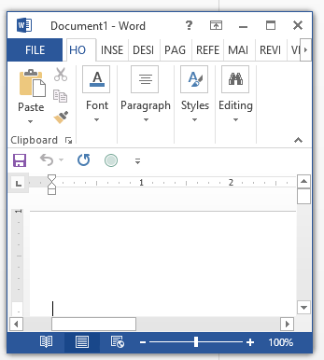
What documents?
{
"name": "SmugMug",
"permalink": "smugmug",
"homepage_url": "http://www.smugmug.com",
"blog_url": "http://blogs.smugmug.com/",
"category_code": "photo_video",
"products": [
{
"name": "SmugMug",
"permalink": "smugmug"
}
],
"offices": [
{
"description": "",
"address1": "67 E. Evelyn Ave",
"address2": "",
"zip_code": "94041",
"city": "Mountain View",
"state_code": "CA",
"country_code": "USA",
"latitude": 37.390056,
"longitude": -122.067692
}
]
}
Perfect for: schema-agnostic JSON store for hierarchical and denormalized data at scale
Not Word documents
Notes:
DocumentDB is ideal for well-nested database documents with multiple properties and values.
It is not intended for Word or other application document storage.

Slide 27
Well-suited for web and mobile apps
Ideal Scenarios
Catalog data
Preferences and state
Event store
User-generated content
Data exchange
Notes:
DocDB is particularly suited for web and mobile application development of all types, but a few scenarios seem to be great fit for the service and we’ve seen these scenarios in the private preview.
Catalog Data
Store, query and process entities – people, places, things
Evolve item schema and attributes based on application needs
Tune indexing to match query and performance needs
Examples include product catalogs, user profiles, device information i.e. IoT systems
Preferences and State
Store user preference data for application experiences and UI customization
Store application information including game state or device configuration information
Support cross document transactions i.e. item transfer or concurrent add/remove operations
Event Store
Process store and query device and application events in near real time i.e. IoT systems
Partition data as time-series or by source ID
Expose web APIs and application experiences over event data with diverse structure
Archive or delete data as it ages out
User Generated Content
Store user generated content such as blogs, comments, annotations.
Support varying properties based on consumption platform (web, mobile)
Rapidly evolve schema based on application needs
Data Exchange
Consume, aggregate and serve data from a variety of sources
Adapt to evolving schemas
Offer queries over heterogeneous document structures
Scale data consumption or delivery from disparate sources

Slide 29
Azure Event Hubs
Massive scale event and telemetry ingestion (ingress)
One way flow
Time based retention
Revocation list for managing senders
Producer
Service Bus
Consumer
sender
Event Hub
Worker
sender
sender
sender
Worker
sender

Slide 30


Azure IoT Hubs
IoT Hub
Event processing and insight
(e.g. hot and cold paths)
IP-capable
Cloud protocol
gateway
Field gateway
Device business logic,
Connectivity monitoring
PAN-devices
Application
device provisioning and management
field
cloud

Slide 31
Azure IoT Hubs
Functionality
Device-to-cloud telemetry,
Cloud-to-device commands and notifications,
File uploads/downloads
Security
Device security,
Cloud security,
Channel security, …
Monitoring
Identify malfunctioning devices when they cannot be reached directly
Reach and customization
RTOS/Linux/Windows/non-IP capable,
Network/application protocols,
Authentication schemes
IoT Hub
IP-capable
Cloud protocol
gateway
Field gateway
PAN-devices

Slide 32
Orb of Intelligence Blog Post here: http://bit.ly/orbofintelligence
@AmyKateNicho

Slide 33






Twitter Sentiment Orb: Architecture
@AmyKateNicho
Notes:
Twitter Data sent to the Text Analytics Machine Learning API and scored (positive/negative sentiment)
Raw tweet data + prediction is sent to Event Hubs – A large data ingestion service in Azure.
Now we have every single tweet with a specified hashtag or keyword being sent to Azure so we want to average the current sentiment of the large amount of data. We use Stream Analytics to write T-SQL queries that averages the sentiment over the last 10 sec (can change the window space) and output this to another Event Hub.
The output event hub is sending the averaged sentiment values to a website which shows a glowing orb.
The orb changes colour depending on the sentiment – negative (red), neutral (yellow), positive (green) and all the subtle variations in between.

Slide 34
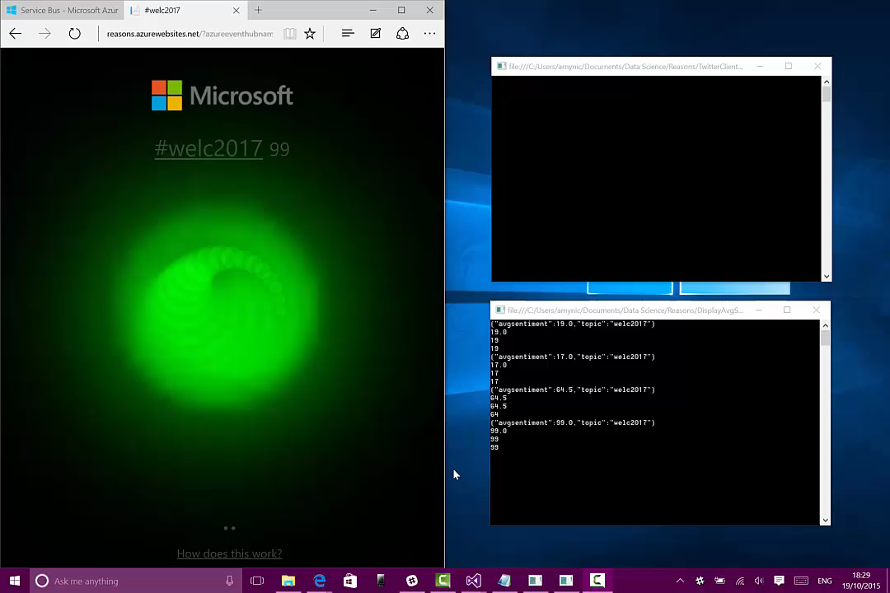
Notes:
A video to show the sentiment orb in action
Sending different tweets to the #welc2017 – both positive and negative to see the orb change colour every 10 secs
Top command line console – a tweet sent with specified hashtag and the sentiment value acquired from the ML API
Bottom command line console – the output event hub details in real time showing the average sentiment at that point in time
Then the website will refresh to show the average sentiment value next to the hashtag and the orb changes colour
The idea around streaming data and machine learning paired together being extremely powerful. Also the visualisation aspect of the story – an orb changing colour showing an immediate understanding of the averaged data – not a large table of values a point in time visual.

Slide 35


Key Takeaways …
Microsoft Imagine Student Gitub https://github.com/MSFTImagine/computerscience
Azure Storage Documentation: https://azure.microsoft.com/en-gb/documentation/services/storage/
All Content from today: https://github.com/amykatenicho/AzureStorageExamples.git
amynic@microsoft.com
@AmyKateNicho
Notes:
Also if cannot use the storage account can still repo demos by using the emulator: https://azure.microsoft.com/en-us/documentation/articles/storage-use-emulator/

